Slide 1





Smart Metal Detection System
ESP32-based IoT Solution with Adafruit IO Integration
Automated sorting system with real-time monitoring and remote control

Slide 2





Project Overview
Smart Detection:
Automatically detects objects
System Architecture
using IR sensor and identifies metal content with
dedicated metal sensor
ESP32 Microcontroller
IoT Integration:
Real-time data transmission to
IR Sensor
Metal Sensor
Adafruit IO platform for remote monitoring and
control
WiFi + MQTT
Adafruit IO Cloud
Automated Sorting:
Relay-controlled
mechanism sorts objects based on metal
detection with manual override capability
Relay Control
LED + Buzzer
Real-time Monitoring:
Tracks object count and
metal detection status with visual and audio
feedback

Slide 3





Main Components of the Logic
WiFi & MQTT Setup
Object Detection
Establishes connection to WiFi network and
Adafruit IO
via
IR sensor
detects objects passing through the system.
MQTT protocol. Subscribes to relay-control feed and
Uses state tracking to avoid duplicate counting and
publishes to object-count and metal feeds.
publishes count updates to the cloud.
Metal Detection
Relay Control Logic
Metal sensor
identifies metallic objects. Triggers LED
Supports both
automatic mode
(based on metal
detection) and
indicators, buzzer alerts, and controls relay operation
manual mode
(remote control via Adafruit
IO commands).
based on detection results.

Slide 4



WiFi and MQTT Setup
WiFi Configuration
1
Initialize WiFi Client
The ESP32 connects to the local WiFi network using credentials:
Create WiFi client object
const char*
ssid
= "Moto";
const char*
password
= "123456789";
void
connectToWiFi
() {
2
Connect to WiFi Network
WiFi.begin(ssid, password);
Using SSID and password
while (WiFi.status() != WL_CONNECTED) {
delay(500);
}
}
3
Initialize MQTT Client
With Adafruit IO server details
MQTT Client Setup
Adafruit IO connection parameters:
4
Subscribe to Control Feed
#define
AIO_SERVER
"io.adafruit.com"
Listen for relay-control commands
#define
AIO_SERVERPORT
1883
#define
AIO_USERNAME
"username"
#define
AIO_KEY
"key here"
Adafruit_MQTT_Client
mqtt(&client, AIO_SERVER,
Publish to Data Feeds
AIO_SERVERPORT, AIO_USERNAME, AIO_KEY);
5
Send object count and metal status

Slide 5




Object Detection with IR Sensor
How It Works
Object Detection Process
The IR sensor emits infrared light and detects its reflection.
When an object passes through:
Sensor output changes from
HIGH to LOW
System detects this state change
Object counter increments
Count is published to Adafruit IO
Implementation
The system uses a state flag (
laserState
) to prevent
multiple counts of the same object.
bool objectDetected = digitalRead(IR_SENSOR) == LOW;
if (laserState == HIGH && objectDetected) {
count++;
laserState = LOW;
countFeed.publish((int32_t)count);
} else if (!objectDetected) {
laserState = HIGH;
}

Slide 6




Metal Detection
How It Works
1
Object passes through metal detector sensor
The metal sensor monitors objects passing through the system. When metal is detected, it triggers visual and audio indicators and controls the relay based on the current mode.
2
System checks if in automatic or manual mode
Implementation
The metal detection logic checks the sensor pin and takes
appropriate actions:
3
If metal detected: Red LED + Buzzer ON
// Metal detection (only in AUTO mode)
bool metalDetected = digitalRead(METAL_SENSOR_PIN) ==
LOW;
if (!manualRelayMode) {
if (metalDetected) {
// No metal detected actions
digitalWrite(RELAY, HIGH);
4
If metal detected: Relay turns OFF (in auto mode)
} else {
// Metal detected actions
digitalWrite(RELAY, LOW);
}
}
5
Metal detection status sent to Adafruit IO

Slide 7




Relay Control Logic
Automatic Mode
Manual Mode
Default behavior where relay control is based on metal detection results.
Override automatic behavior with direct commands from Adafruit IO.
if (!manualRelayMode) {
if (value.equalsIgnoreCase("ON")) {
if (metalDetected) {
digitalWrite(RELAY, HIGH);
// No metal detected
manualRelayMode = true
;
digitalWrite(RELAY,
HIGH
);
} else if (value.equalsIgnoreCase("OFF")) {
} else {
digitalWrite(RELAY, LOW);
// Metal detected
manualRelayMode = true
;
digitalWrite(RELAY,
LOW
);
} else if (value.equalsIgnoreCase("AUTO")) {
}
manualRelayMode = false
;
}
}
Object Detected
Command from Adafruit IO
Metal Sensor Check
"ON": Relay ON + Manual Mode
"OFF": Relay OFF + Manual Mode
If No Metal: Relay ON
"AUTO": Return to Automatic Mode
If Metal: Relay OFF

Slide 8

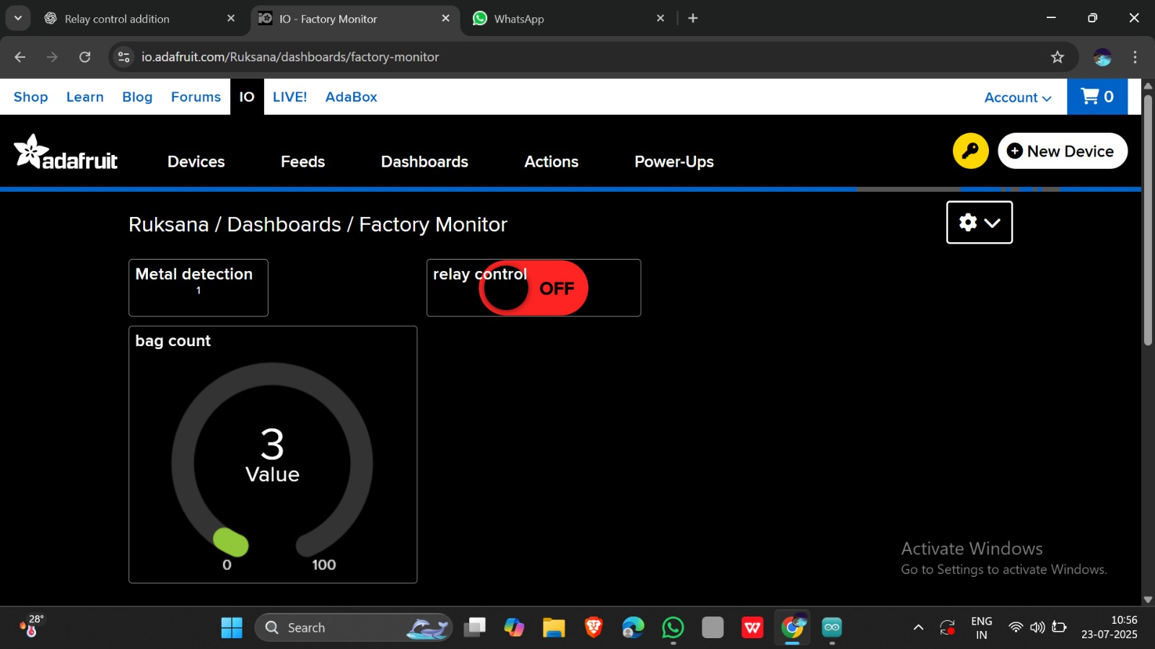
Feed Summary (Adafruit IO)
Feed Name
Purpose
Type
Values
Data Flow Visualization
factory.object-count
Number of detected objects
0, 1, 2, 3, ...
Publish
Metal detection status
"0" (no metal), "1" (metal)
factory.metal
Publish
factory.relay-control
Manual relay control
"ON", "OFF", "AUTO"
Subscribe

Slide 9

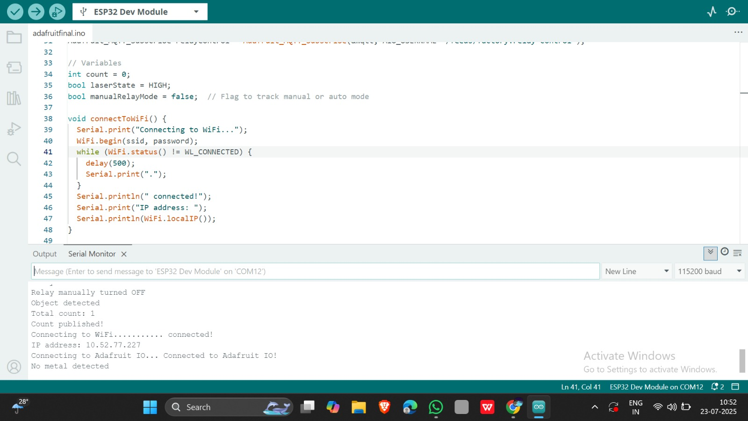
Implementation
1
System Initialization
System powers on and establishes connections to WiFi and Adafruit IO MQTT broker.
2
Object Detection
An object passes through the IR sensor beam. The counter increments
and publishes to
factory.object-count
.
3
Metal Detection & Sorting
No metal:
Green LED on, relay ON, "0" published
Metal:
Red LED & buzzer on, relay OFF, "1" published
4
Remote Control
User sends "OFF" to
relay-control
feed. System enters manual mode.
Later, "AUTO" returns to automatic operation.

Slide 10


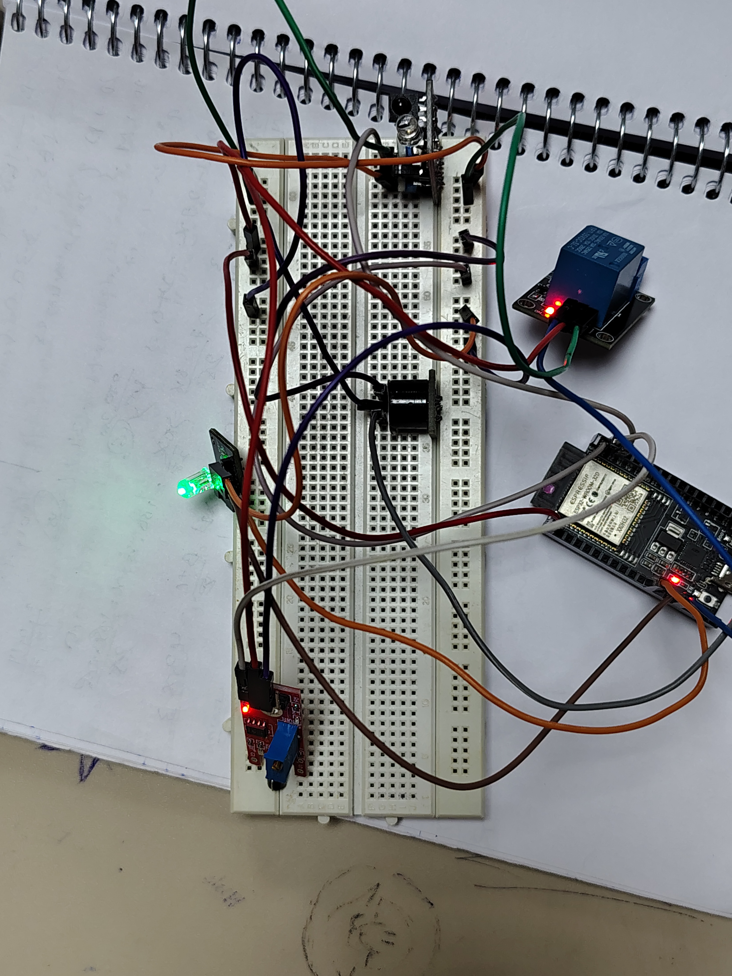

Code Highlights and board connections
Setup Function
void setup()
{
// Configure pin modes
pinMode(METAL_SENSOR_PIN, INPUT);
pinMode(IR_SENSOR, INPUT);
pinMode(LED_GREEN, OUTPUT);
pinMode(LED_RED, OUTPUT);
pinMode(BUZZER, OUTPUT);
pinMode(RELAY, OUTPUT);
// Initialize outputs
digitalWrite(LED_GREEN, LOW);
digitalWrite(LED_RED, LOW);
// Connect to network
connectToWiFi();
mqtt.subscribe(&relayControl);
}
Main Loop
void loop()
{
// Ensure MQTT connection
MQTT_connect();
mqtt.processPackets(1000);
// Object detection logic
bool objectDetected = digitalRead(IR_SENSOR) == LOW;
if (laserState == HIGH && objectDetected) {
count++;
laserState = LOW;
countFeed.publish((int32_t)count);
}
// Metal detection logic
bool metalDetected = digitalRead(METAL_SENSOR_PIN) == LOW;
// Process based on detection...
}

